Slide 2
Hyland Hy-Tech Camp
Cyber Security

Slide 3
Agenda
Introductions
Cyber Security Careers
Paths to Cyber Security
Everyday Security Tips

Slide 4
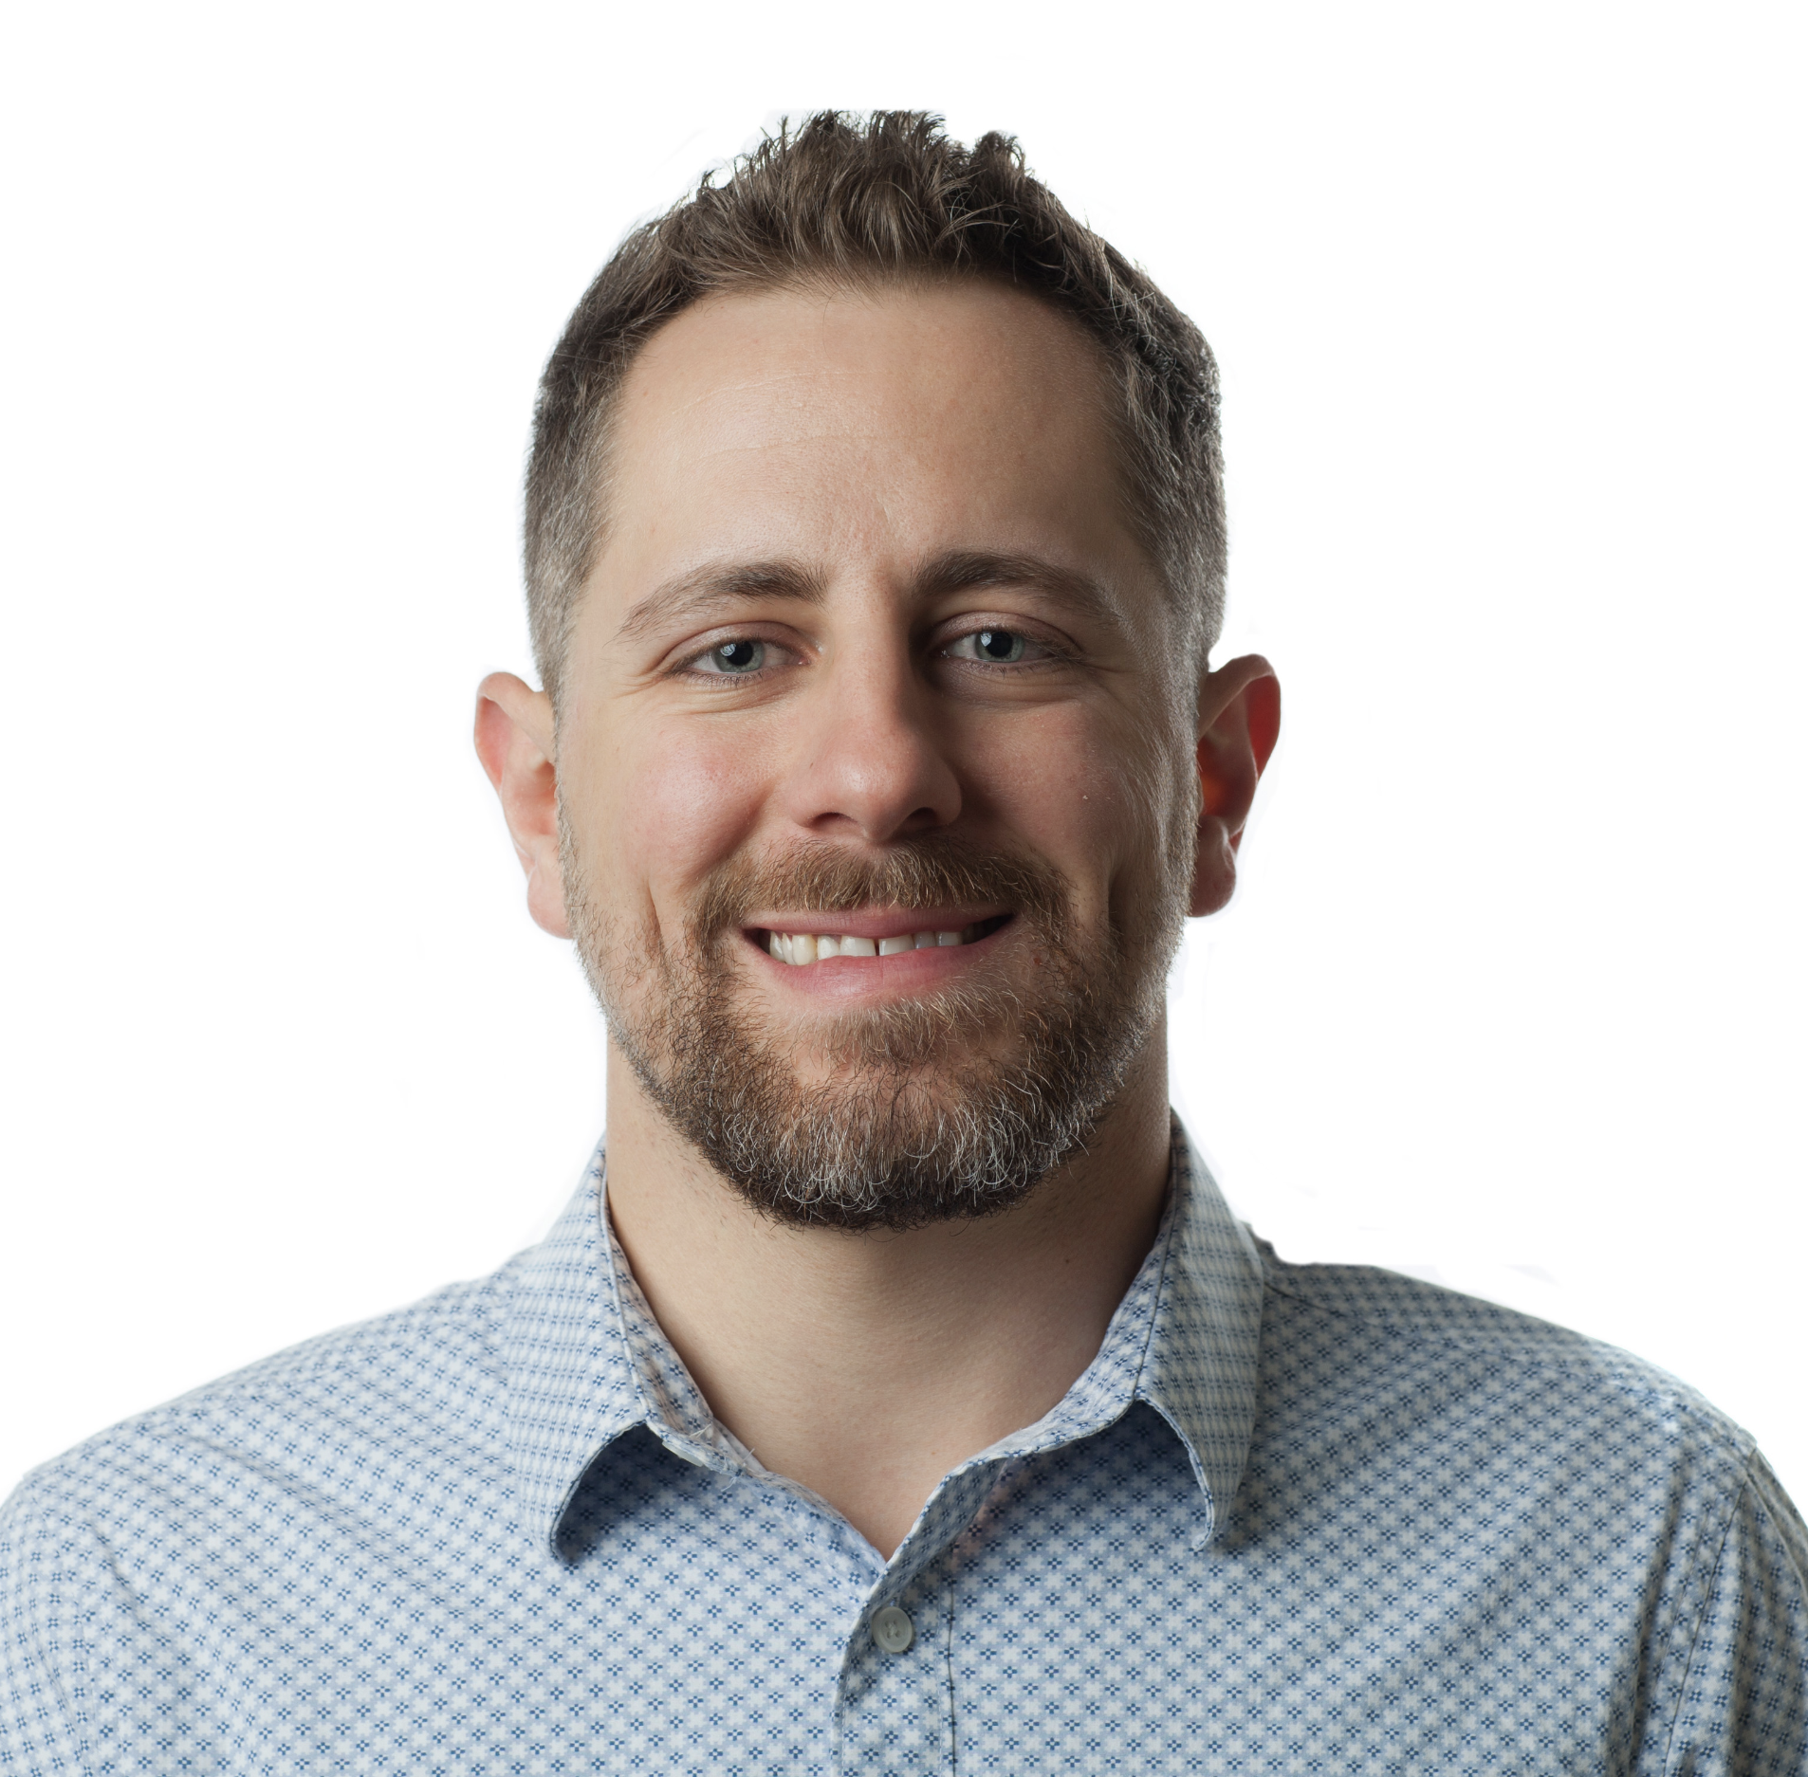
Bryan Hader Cyber Security Analyst
Cleveland, Ohio
Education: University of Oregon B.S. Sociology, Tri-C A.AB Cyber Security
Navy Veteran
8 years IT experience (almost 2 years in Cyber)

Slide 5

Josh Justice Cyber Security Analyst
Cleveland, Ohio
Education: LCCC(Teaching)(Nursing) SNHU – Information Technology
Navy Veteran
12 years IT experience

Slide 6

Eric Cabranes Cyber Security Analyst
Cleveland, Ohio
Education: University of Akron/LCCC B.S. Network Communications Technology
5 Years of IT/Security Experience

Slide 7
Why choose a career in cybersecurity?
~3 million unfilled cybersecurity jobs
Incredibly exciting and challenging
High number of specialties within Cyber Security
You can make a huge impact
Notes:
Who knows someone who works in the medical field?
Who knows someone who works in IT?
Who knows someone who works in Cyber Security?
Not enough cyber security professionals to fill the open roles.

Slide 8
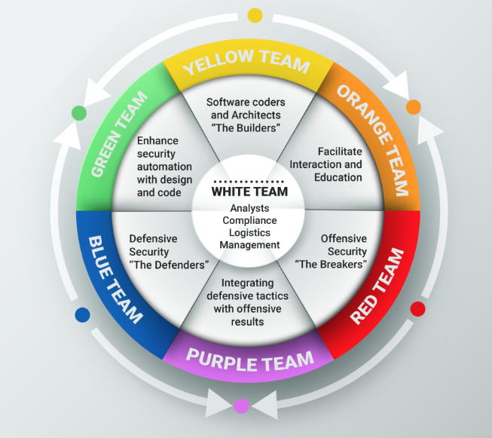
Employment – What do we do?
Notes:
Questions:
What do you think X team would do?

Slide 9


Employment
Compliance & Governance
Compliance Frameworks & Certifications
HIPPA & PCI
Technical vs Nontechnical Roles in Cyber Security

Slide 10

How to get into the Field
Multiple Paths to the Cyber Security Field
University
Certifications
Help Desk / Support
Internships
Self Study
Military
There's no right or wrong way
Notes:
Questions:
Internship?
Questions about the field that they may have

Slide 11
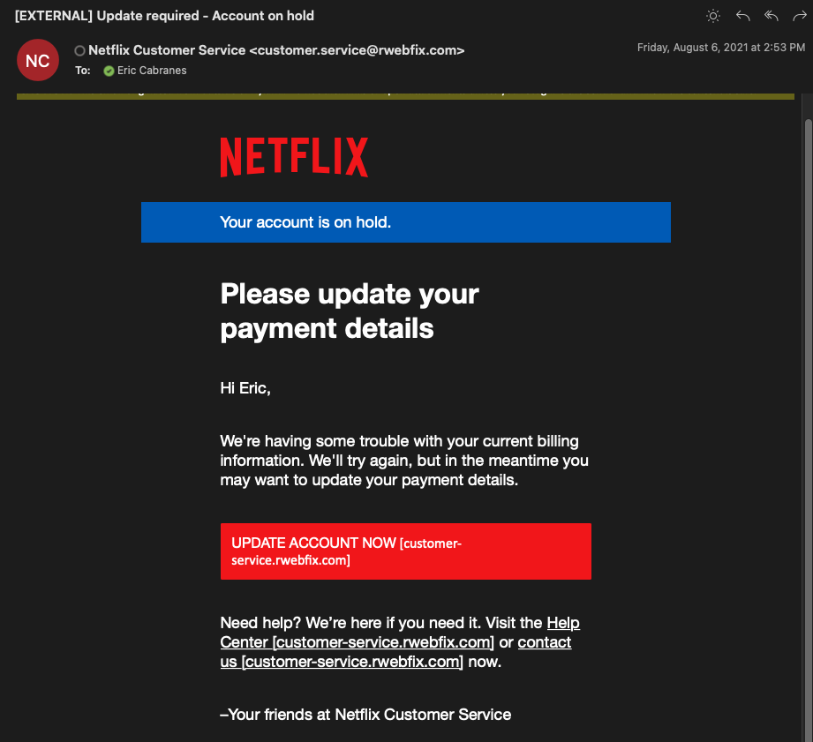
Types of Attacks – Phishing Social Engineering

Slide 12
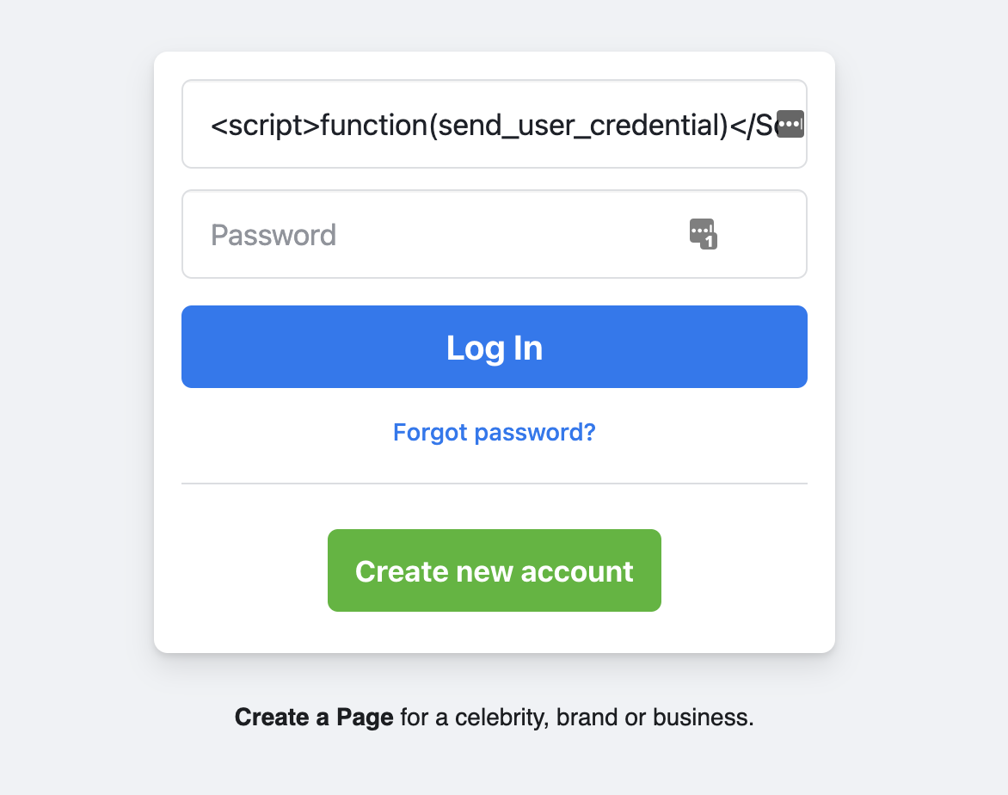
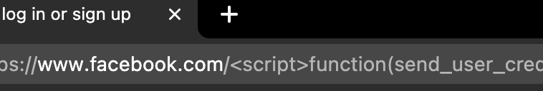
Types of attacks – what are we up against?
Attacks on Websites
Cross-site Scripting
Denial of Service

Slide 13
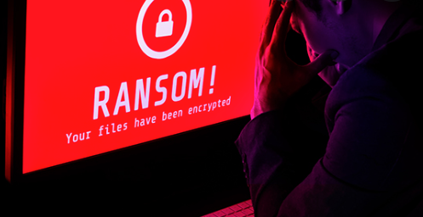
Types of attacks – what are we up against?
Ransomware
Virus that Encrypts/Locks files on your computer
Forces you to pay to get the key to unlock them
Average ransom payments reached $812,000 in 2021
WannaCry Ransomware Demonstration
Notes:
Who knows what ransomware is?

Slide 14
Types of attackers
Nation-state
Source of Income
North Korea - $2 billion stolen via crypto attacks/scams
Military
Funding for weapons systems like nukes and ICBM
Stuxnet
Corporate Espionage
Why engineer new technology when we can steal it?
Saves time and money on R&D
US Government
CIA/FBI/DHS

Slide 15

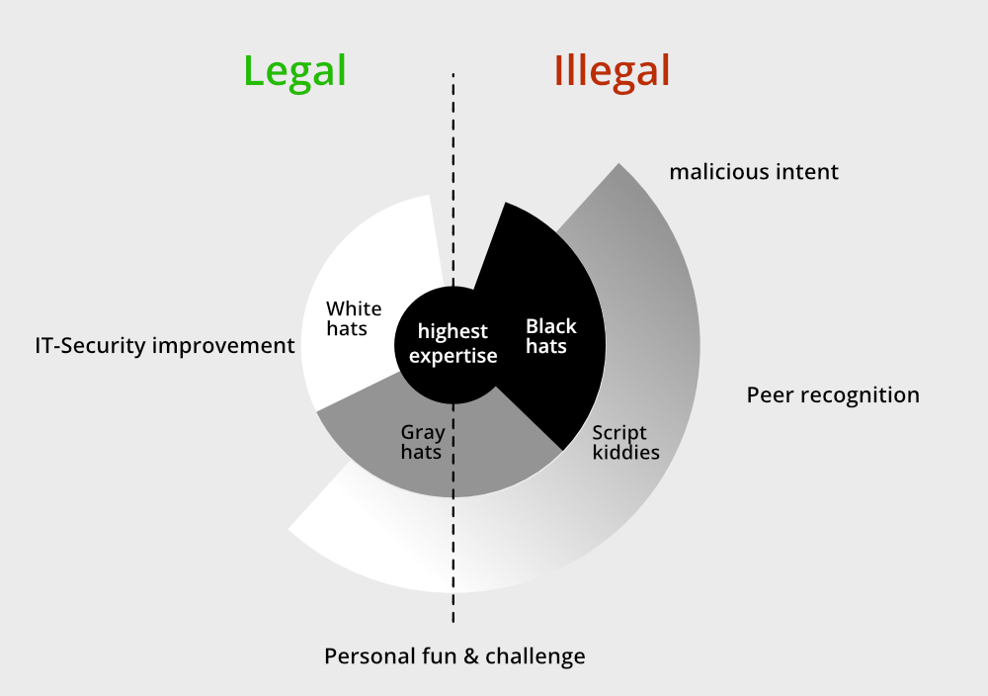


Types of attackers

Slide 16
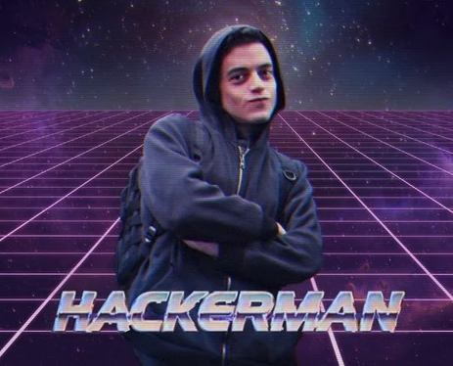
Types of Attackers
Researchers
Bug Bounty Programs
Help big companies find flaws in their code
HackerOne Leaderboards
Hobby - They’re good at finding vulnerable code and capitalize on it
Reputation
Resume Building
Cyber Security Firms
Brand Recognition
Trust from the Community

Slide 17
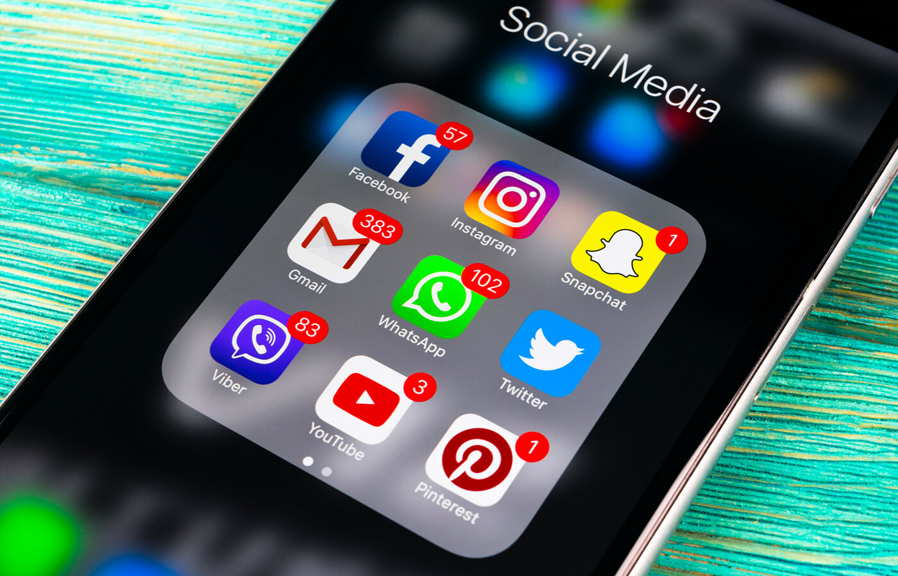
Everyday Security tips – Privacy/Social Media
Privacy
Limiting personal information on Social Media
Attackers can use this information to gain your trust
Use a VPN when you’re on a public/untrusted network
“Don’t talk to strangers”
Notes:
Who here uses no social media platforms?
For those who do, have you ever seen someone post something super personal that makes you cringe (TMI).
Just because you can share it, and other people are sharing it, doesn’t mean you should share it.
Have you ever accepted a friend request from someone you’ve never personally met?

Slide 18

Everyday Security tips - Software
Downloading Software
“Free” Games/Movies/Music
Too Good to be True
Loaded with Malware!
Is this website legitimate & reputable?
Go directly to the company’s website
EX: Download Microsoft word from Microsoft’s website
Notes:
Raise your hand if you play computer games.
Anyone remember Napster/Limewire?
Spotify
Netflix

Slide 19
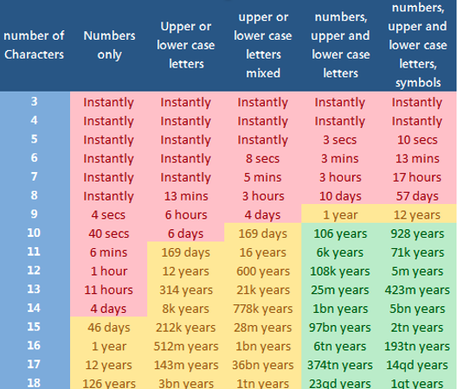
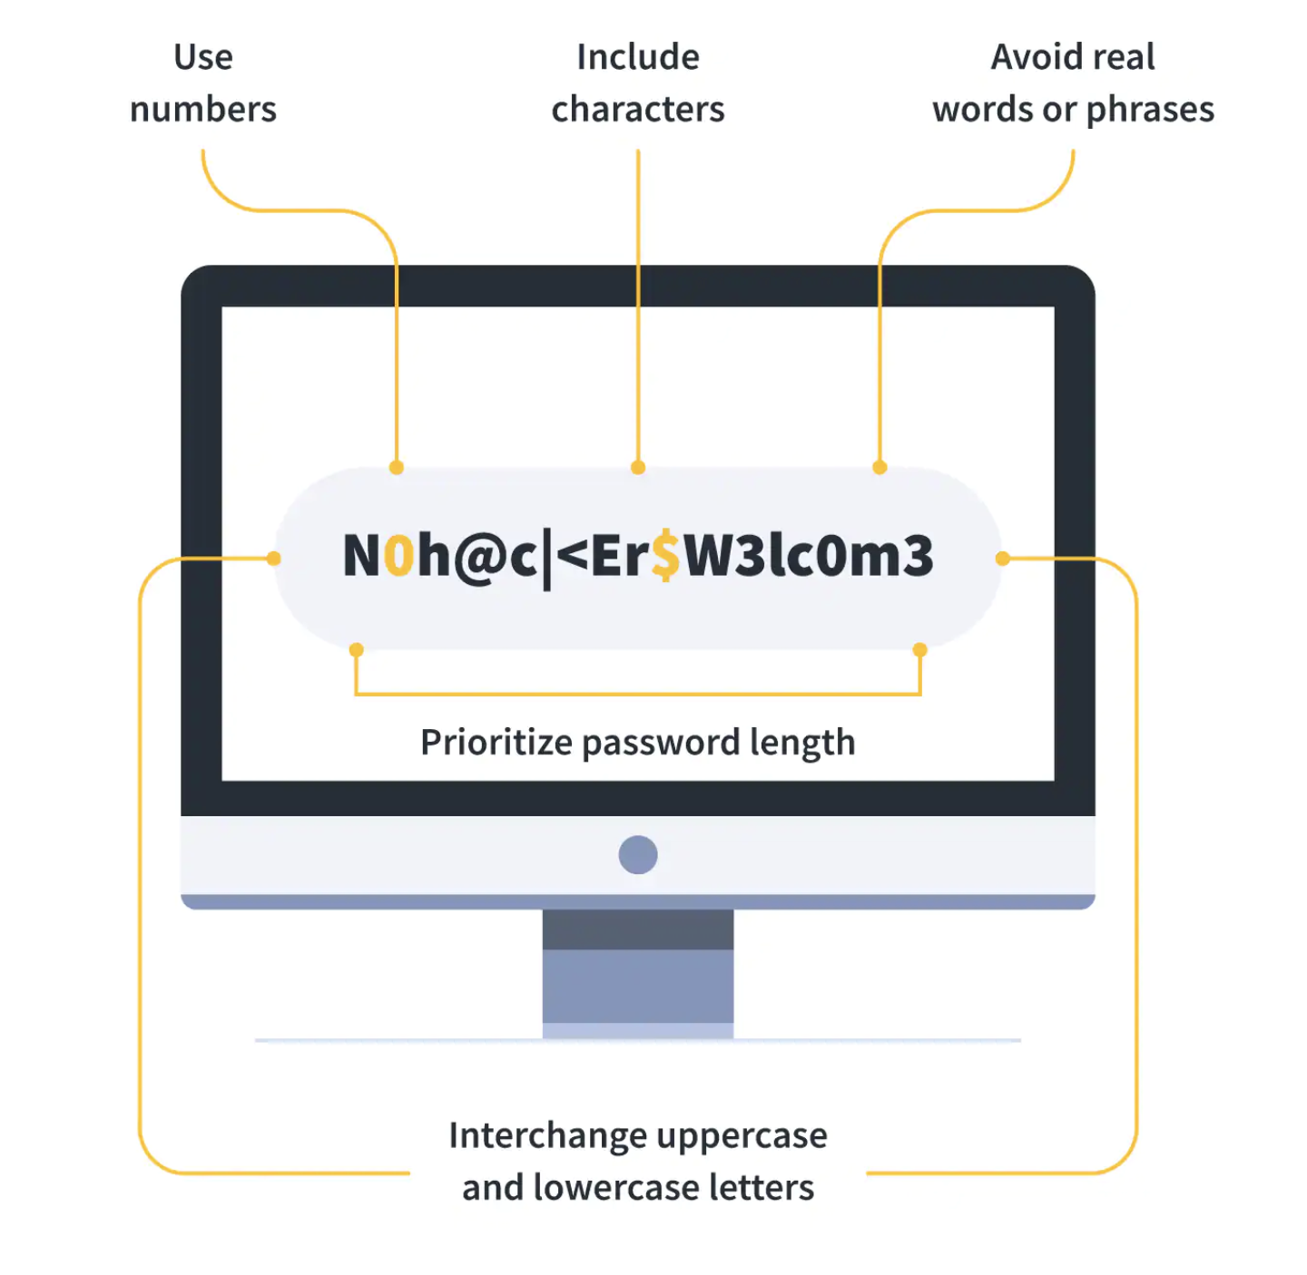
Everyday Security tips - Passwords
Password Complexity
Never Re-use Passwords
Avoid Dictionary Words

Slide 20
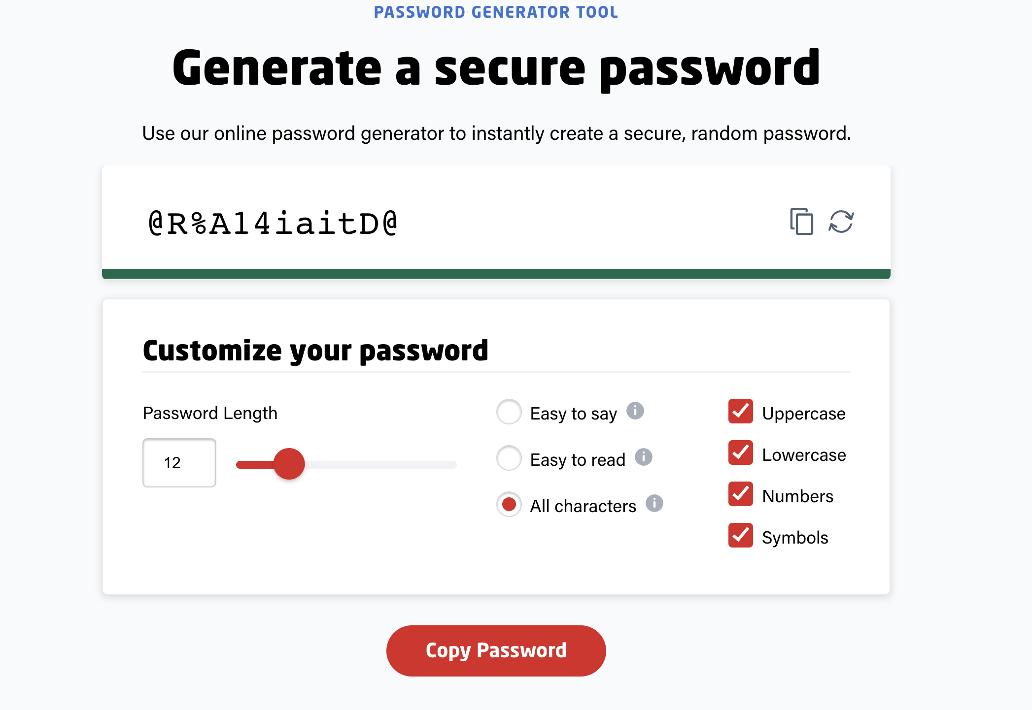
Everyday Security tips - Passwords
Password Vaults
LastPass
KeePass
1Password

Slide 21
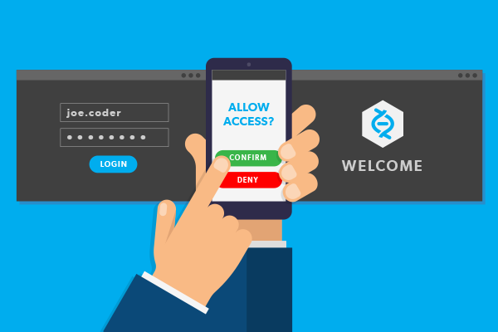
Everyday Security tips – Multi Factor Authentication
1st Factor – Something You Know
Password
2nd Factor – Something you have
Authenticator App (Click to Approve Sign-in)
Cell Phone Number (Text Verification)
Most websites in 2022 offer some form of MFA

Slide 22
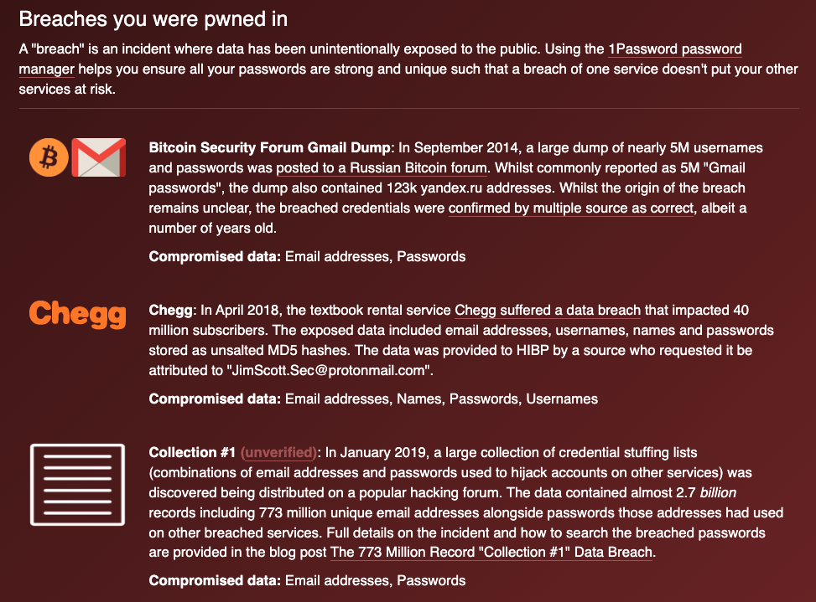
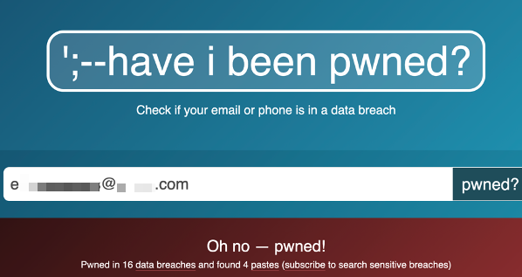
Everyday Security tips - Passwords
https://haveibeenpwned.com/

Slide 23
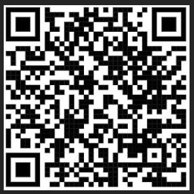

Slide 24
Thank you!

